Slide 1
Uc11-teste de front end game mania
Matheus lemos carvalho

Slide 2
Plano de teste
Objetivo de testar a funcionalidade do “Login/Cadastro”.
Site em angular , deixar o servidor ativo para a realização do teste.
Software utilizados: Eclipse, JDK-8, WebDriver, Apache Maven.

Slide 3
Caso de teste
Usuário acessar o home através do “http://localhost:4200/”.
Ao interagir com o site e clicar no botão Login/Cadastro ser redirecionado de forma correta.

Slide 4
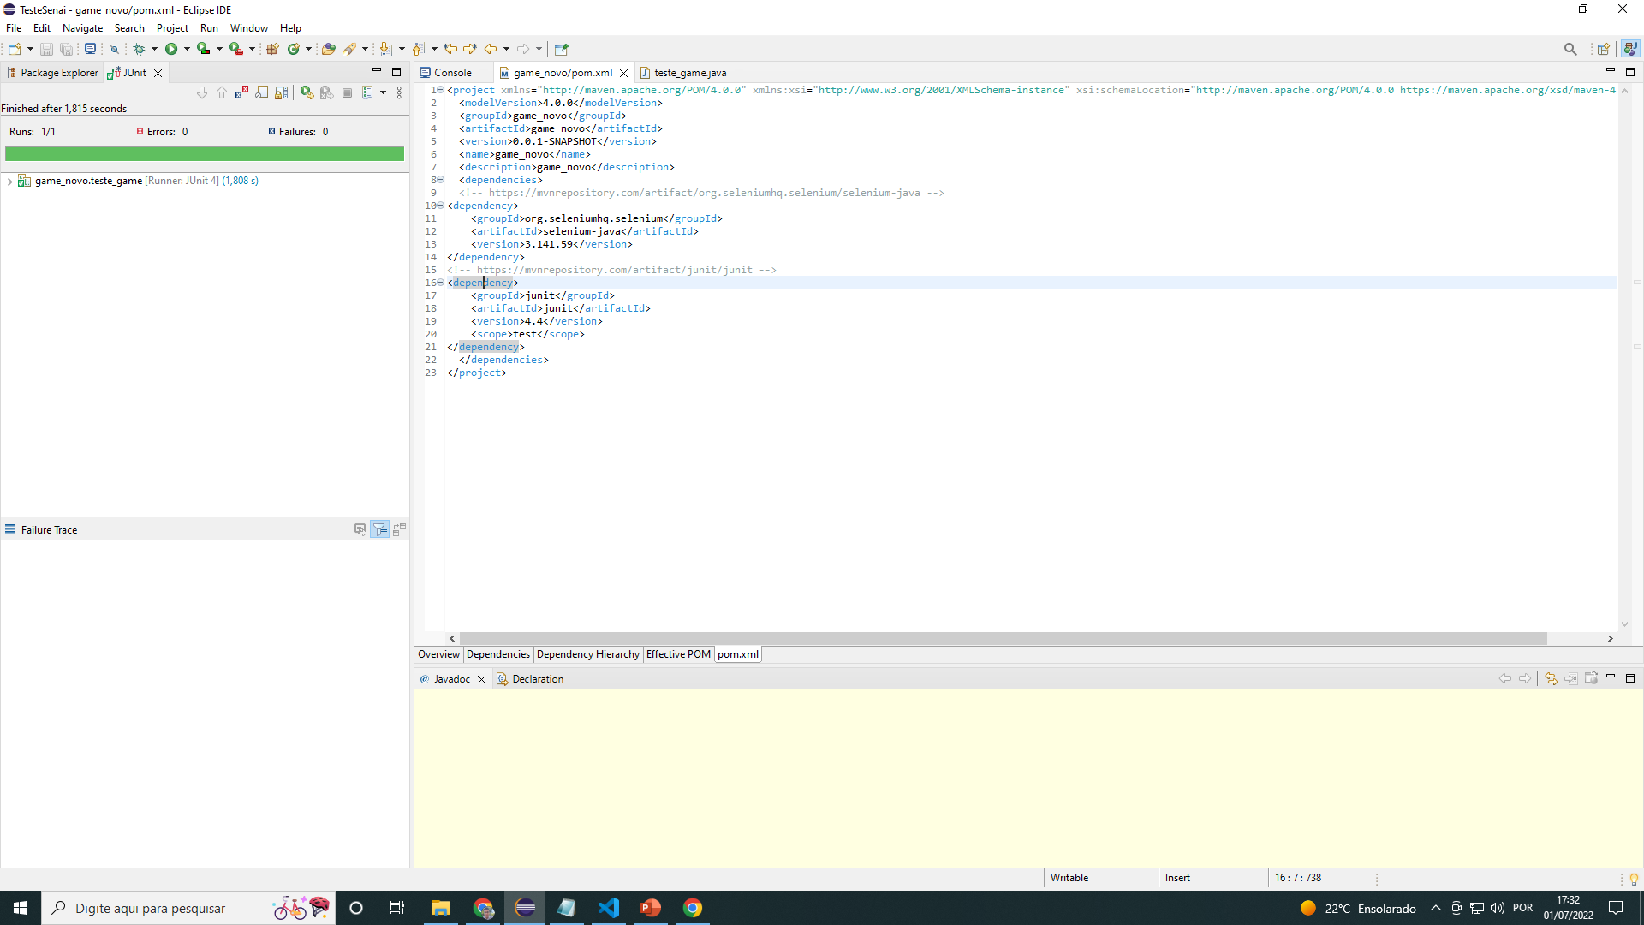
Print teste: pom xml Game mania

Slide 5
Código do pom xml
<project xmlns="http://maven.apache.org/POM/4.0.0" xmlns:xsi="http://www.w3.org/2001/XMLSchema-instance" xsi:schemaLocation="http://maven.apache.org/POM/4.0.0 https://maven.apache.org/xsd/maven-4.0.0.xsd">
<modelVersion>4.0.0</modelVersion>
<groupId>game_novo</groupId>
<artifactId>game_novo</artifactId>
<version>0.0.1-SNAPSHOT</version>
<name>game_novo</name>
<description>game_novo</description>
<dependencies>
<!-- https://mvnrepository.com/artifact/org.seleniumhq.selenium/selenium-java -->
<dependency>
<groupId>org.seleniumhq.selenium</groupId>
<artifactId>selenium-java</artifactId>
<version>3.141.59</version>
</dependency>
<!-- https://mvnrepository.com/artifact/junit/junit -->
<dependency>
<groupId>junit</groupId>
<artifactId>junit</artifactId>
<version>4.4</version>
<scope>test</scope>
</dependency>
</dependencies>
</project>

Slide 6
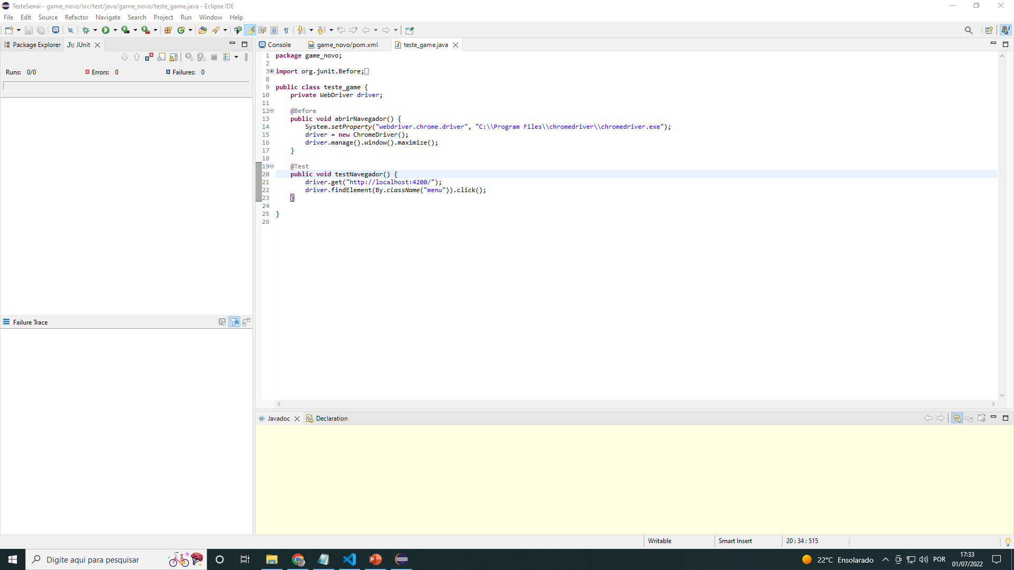
Print teste: java Game mania

Slide 7
Código do java
package game_novo;
import org.junit.Before;
import org.junit.Test;
import org.openqa.selenium.By;
import org.openqa.selenium.WebDriver;
import org.openqa.selenium.chrome.ChromeDriver;
public class teste_game {
private WebDriver driver;
@Before
public void abrirNavegador() {
System.setProperty("webdriver.chrome.driver", "C:\\Program Files\\chromedriver\\chromedriver.exe");
driver = new ChromeDriver();
driver.manage().window().maximize();
}
@Test
public void testNavegador() {
driver.get("http://localhost:4200/");
driver.findElement(By.className("menu")).click();
}
}

Slide 8
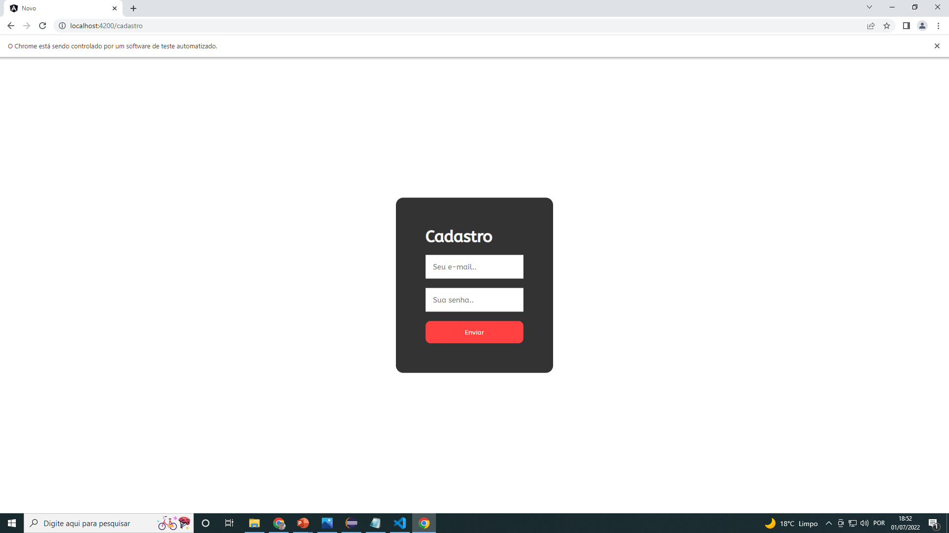
resultado

